Slide 1
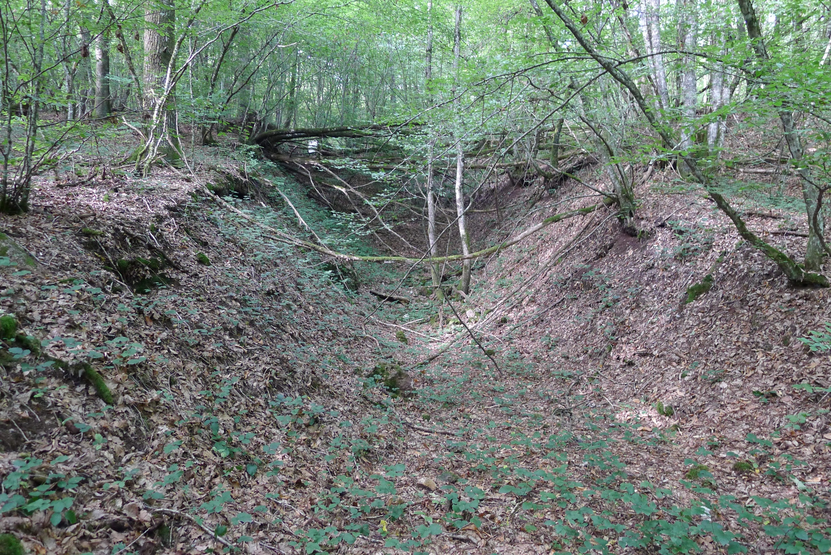
Establishing archaeological prospectivity maps of ancient mines on the basis of EDA and fractal model applied to geochemical data
Monna, F., Gourault, C., Camizuli, E., Nedjai, R., Hamm, G., Cattin, F., Bohard, B., Petit, C., Guillaumet, J.-P., Alibert, P.

Slide 2
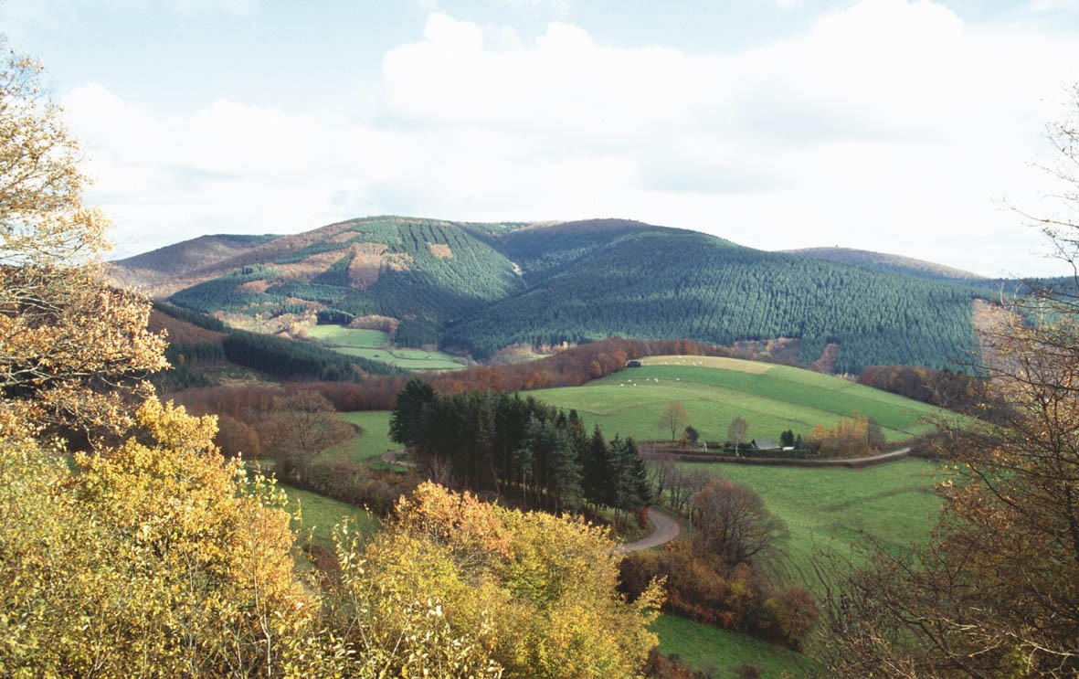
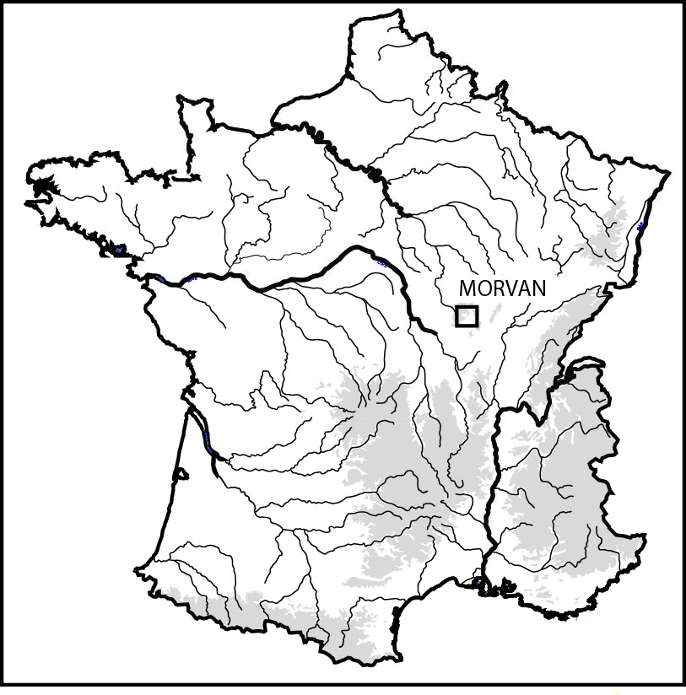
Introduction
The Celtic Aeduan site of Bibracte: the end of the 3rd century BC – ca 15 BC

Slide 3
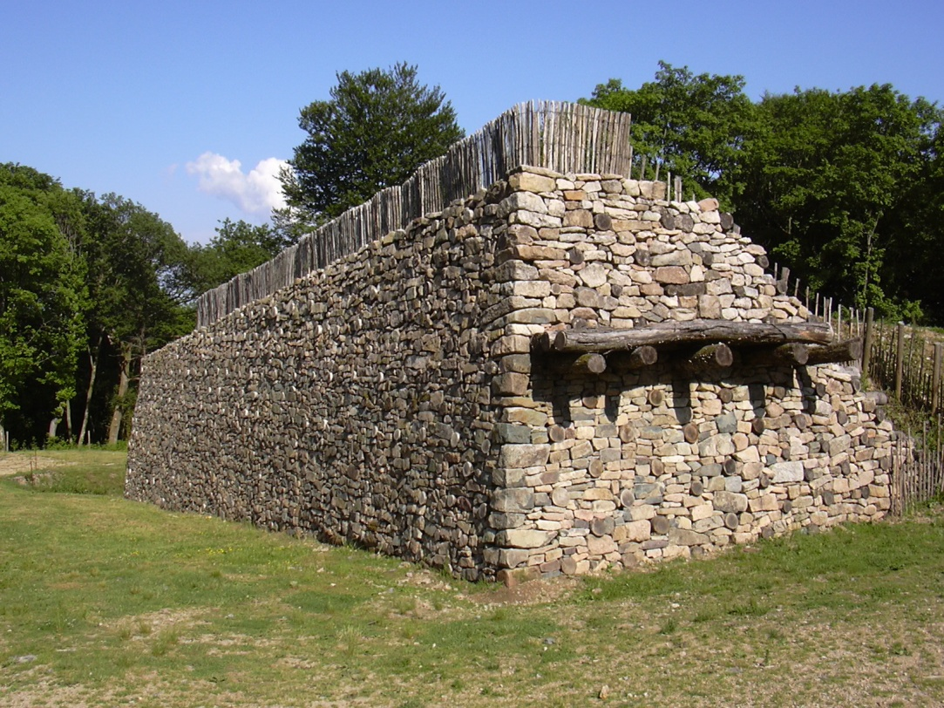
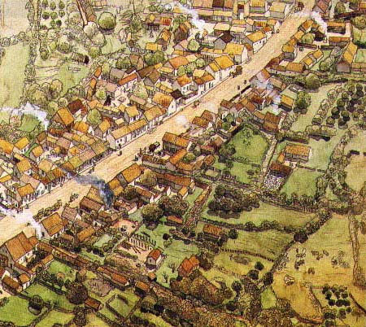
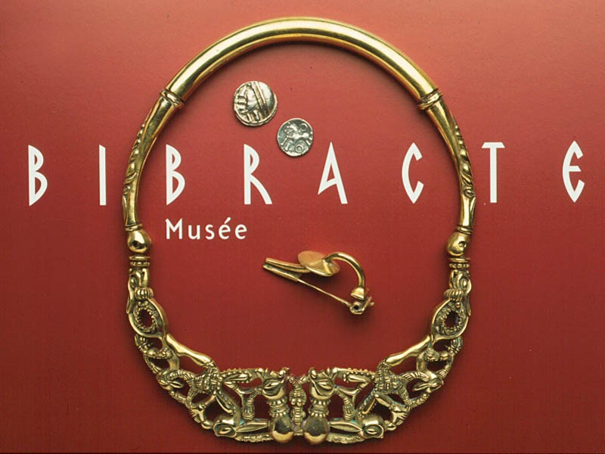
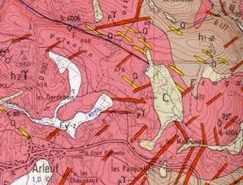
Introduction
Bibracte at the Mount Beuvray, according to C. Goudineau. Drawing by JC Golvin.

Slide 4
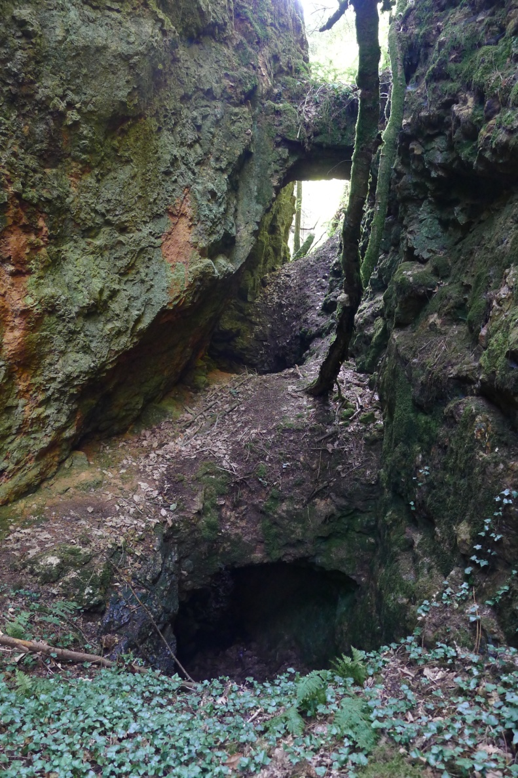
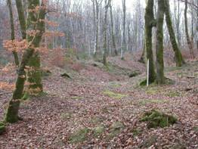
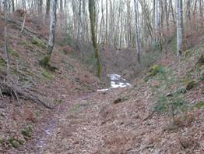
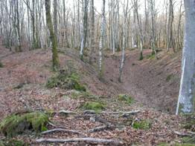
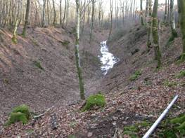
Introduction
Presence of polymetallic ore deposits
Old works (Pb, Ag, Fe, Cu(?), Au(?)…)
Tamas (2004), Gourault (2009)
Recent works (U, F, Ba, Pb)

Slide 5
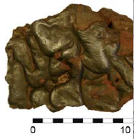
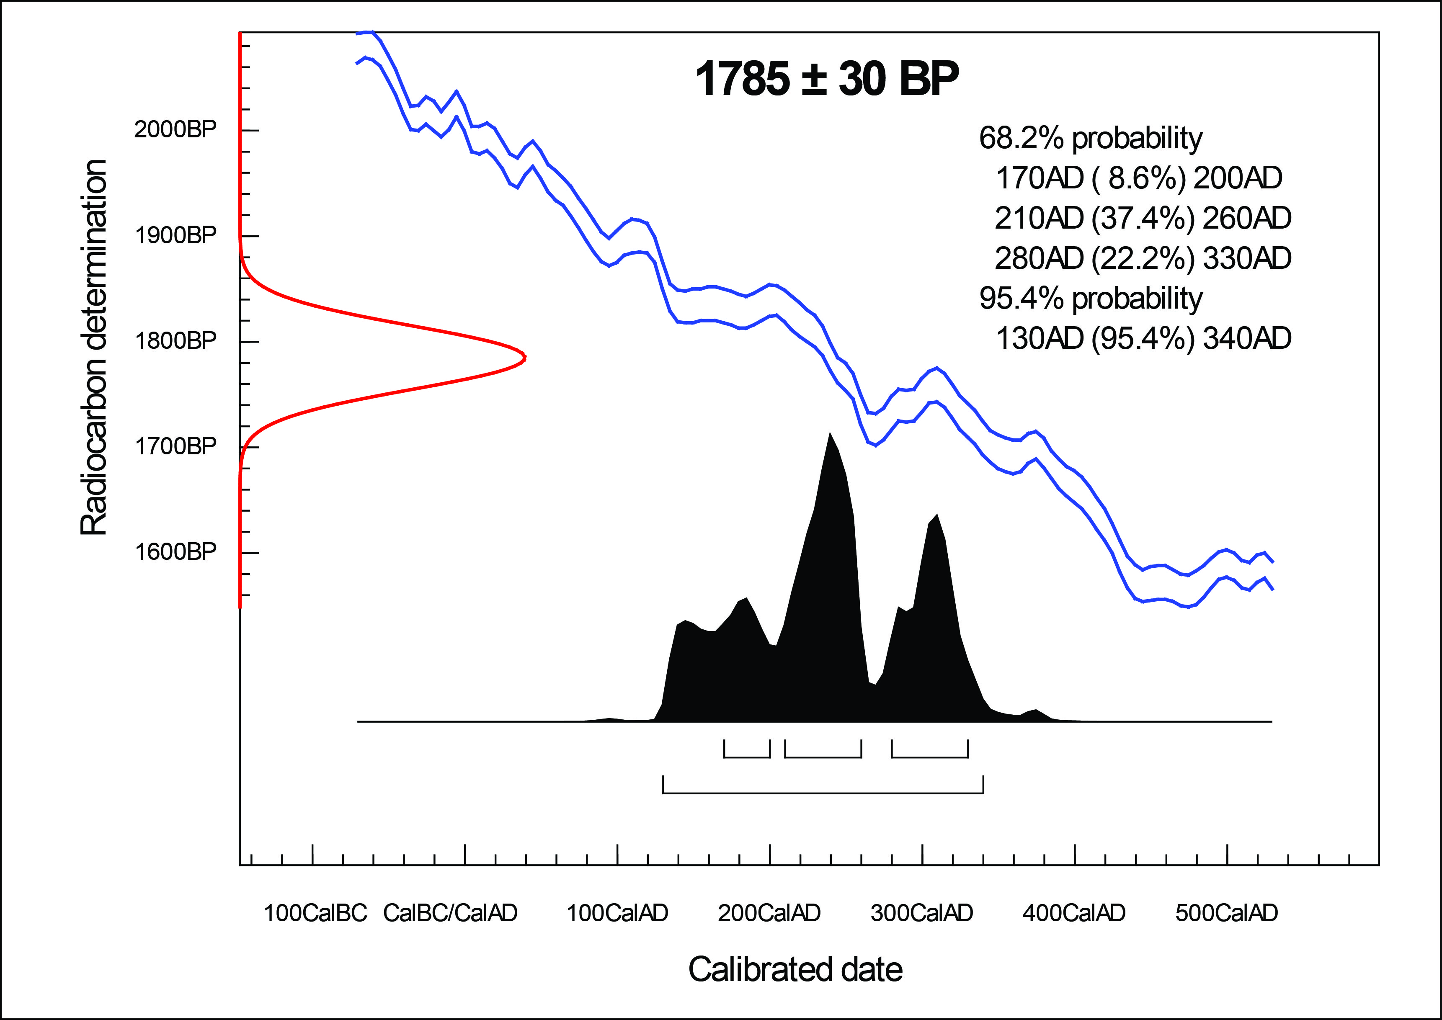
Introduction
Data from Poznan Radiocarbon Laboratory

Slide 6
The aim of the study
Finding new (old/archaeological) mines to better understand the economy related to metal
-> Pedestrial prospection: 2909 km² for the Morvan Park (PNRM) alone!
-> Establishing prospectivity maps using the geochemical database of the BRGM
performed from stream sediment sampling
Aims of the present study
1. Reducing as much as possible the size of the area to be prospected
2. Identifying (if possible) the nature of the mineral substances mined in the past

Slide 7
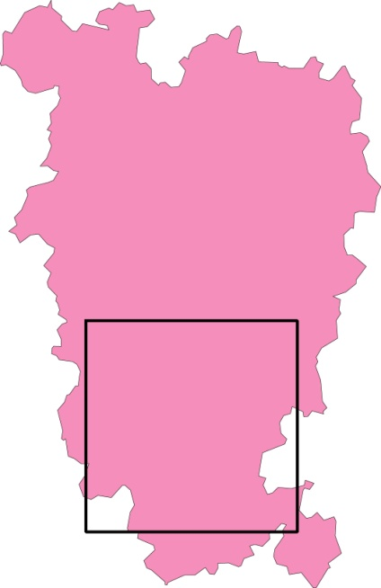
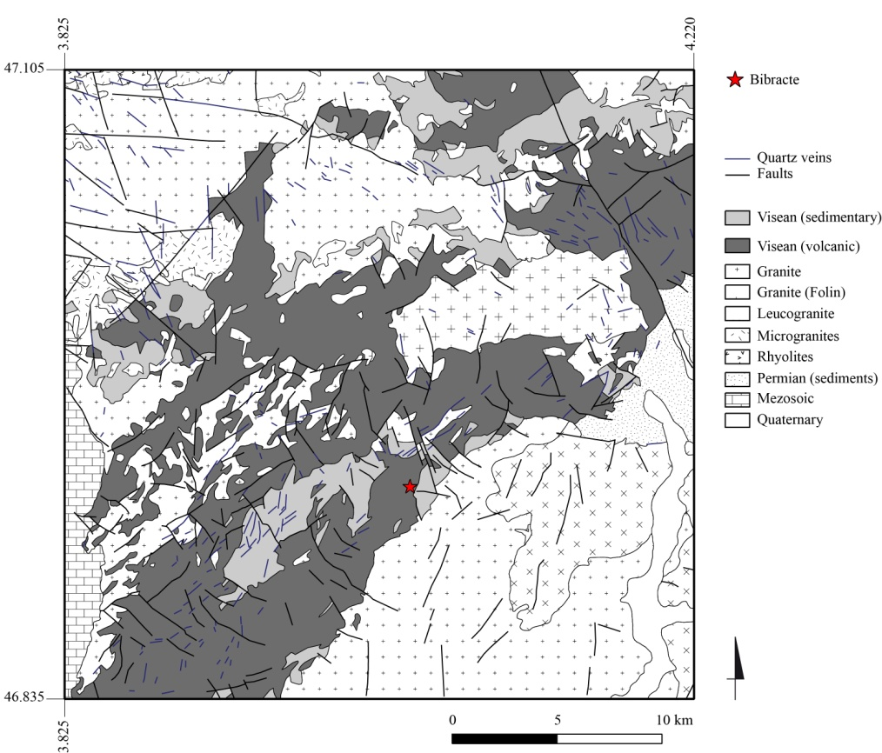
Pilot study site
PNRM
Study site
The pilot study area in the PNRM
A contrasted geology
A targeted area of (only!) 30x30 km²

Slide 8
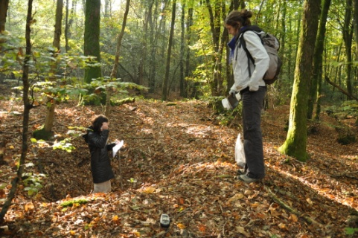
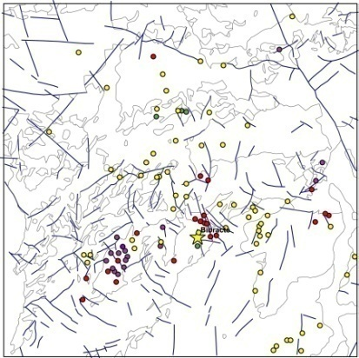
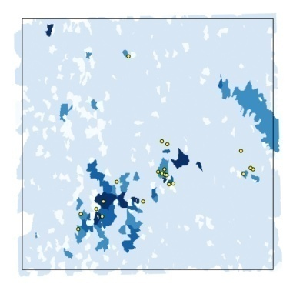
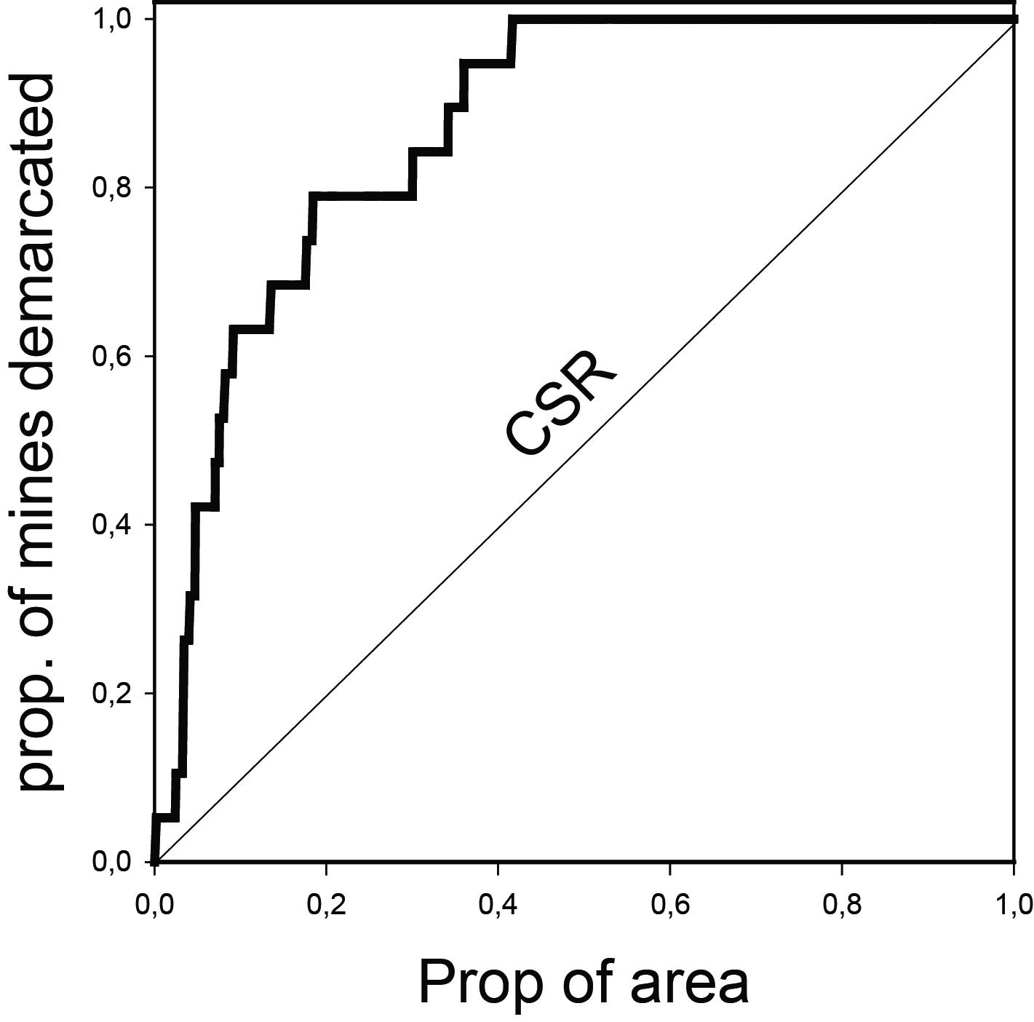
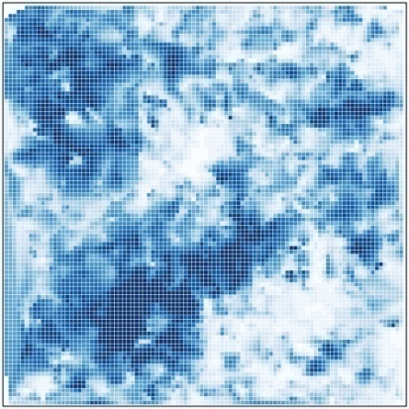
Methodology
Systematic prospection in a constrained area
Mapping the mines discovered
Extrapolating the model to a
wider area
Downloading the georeferenced SSS data from the BRGM database
Treating the data and delineating the geochemical anomalies using a CA-based model and Tukey’s EDA (not shown here)
Crossing the models and the mines discovered. Evaluating the quality of the models

Slide 9
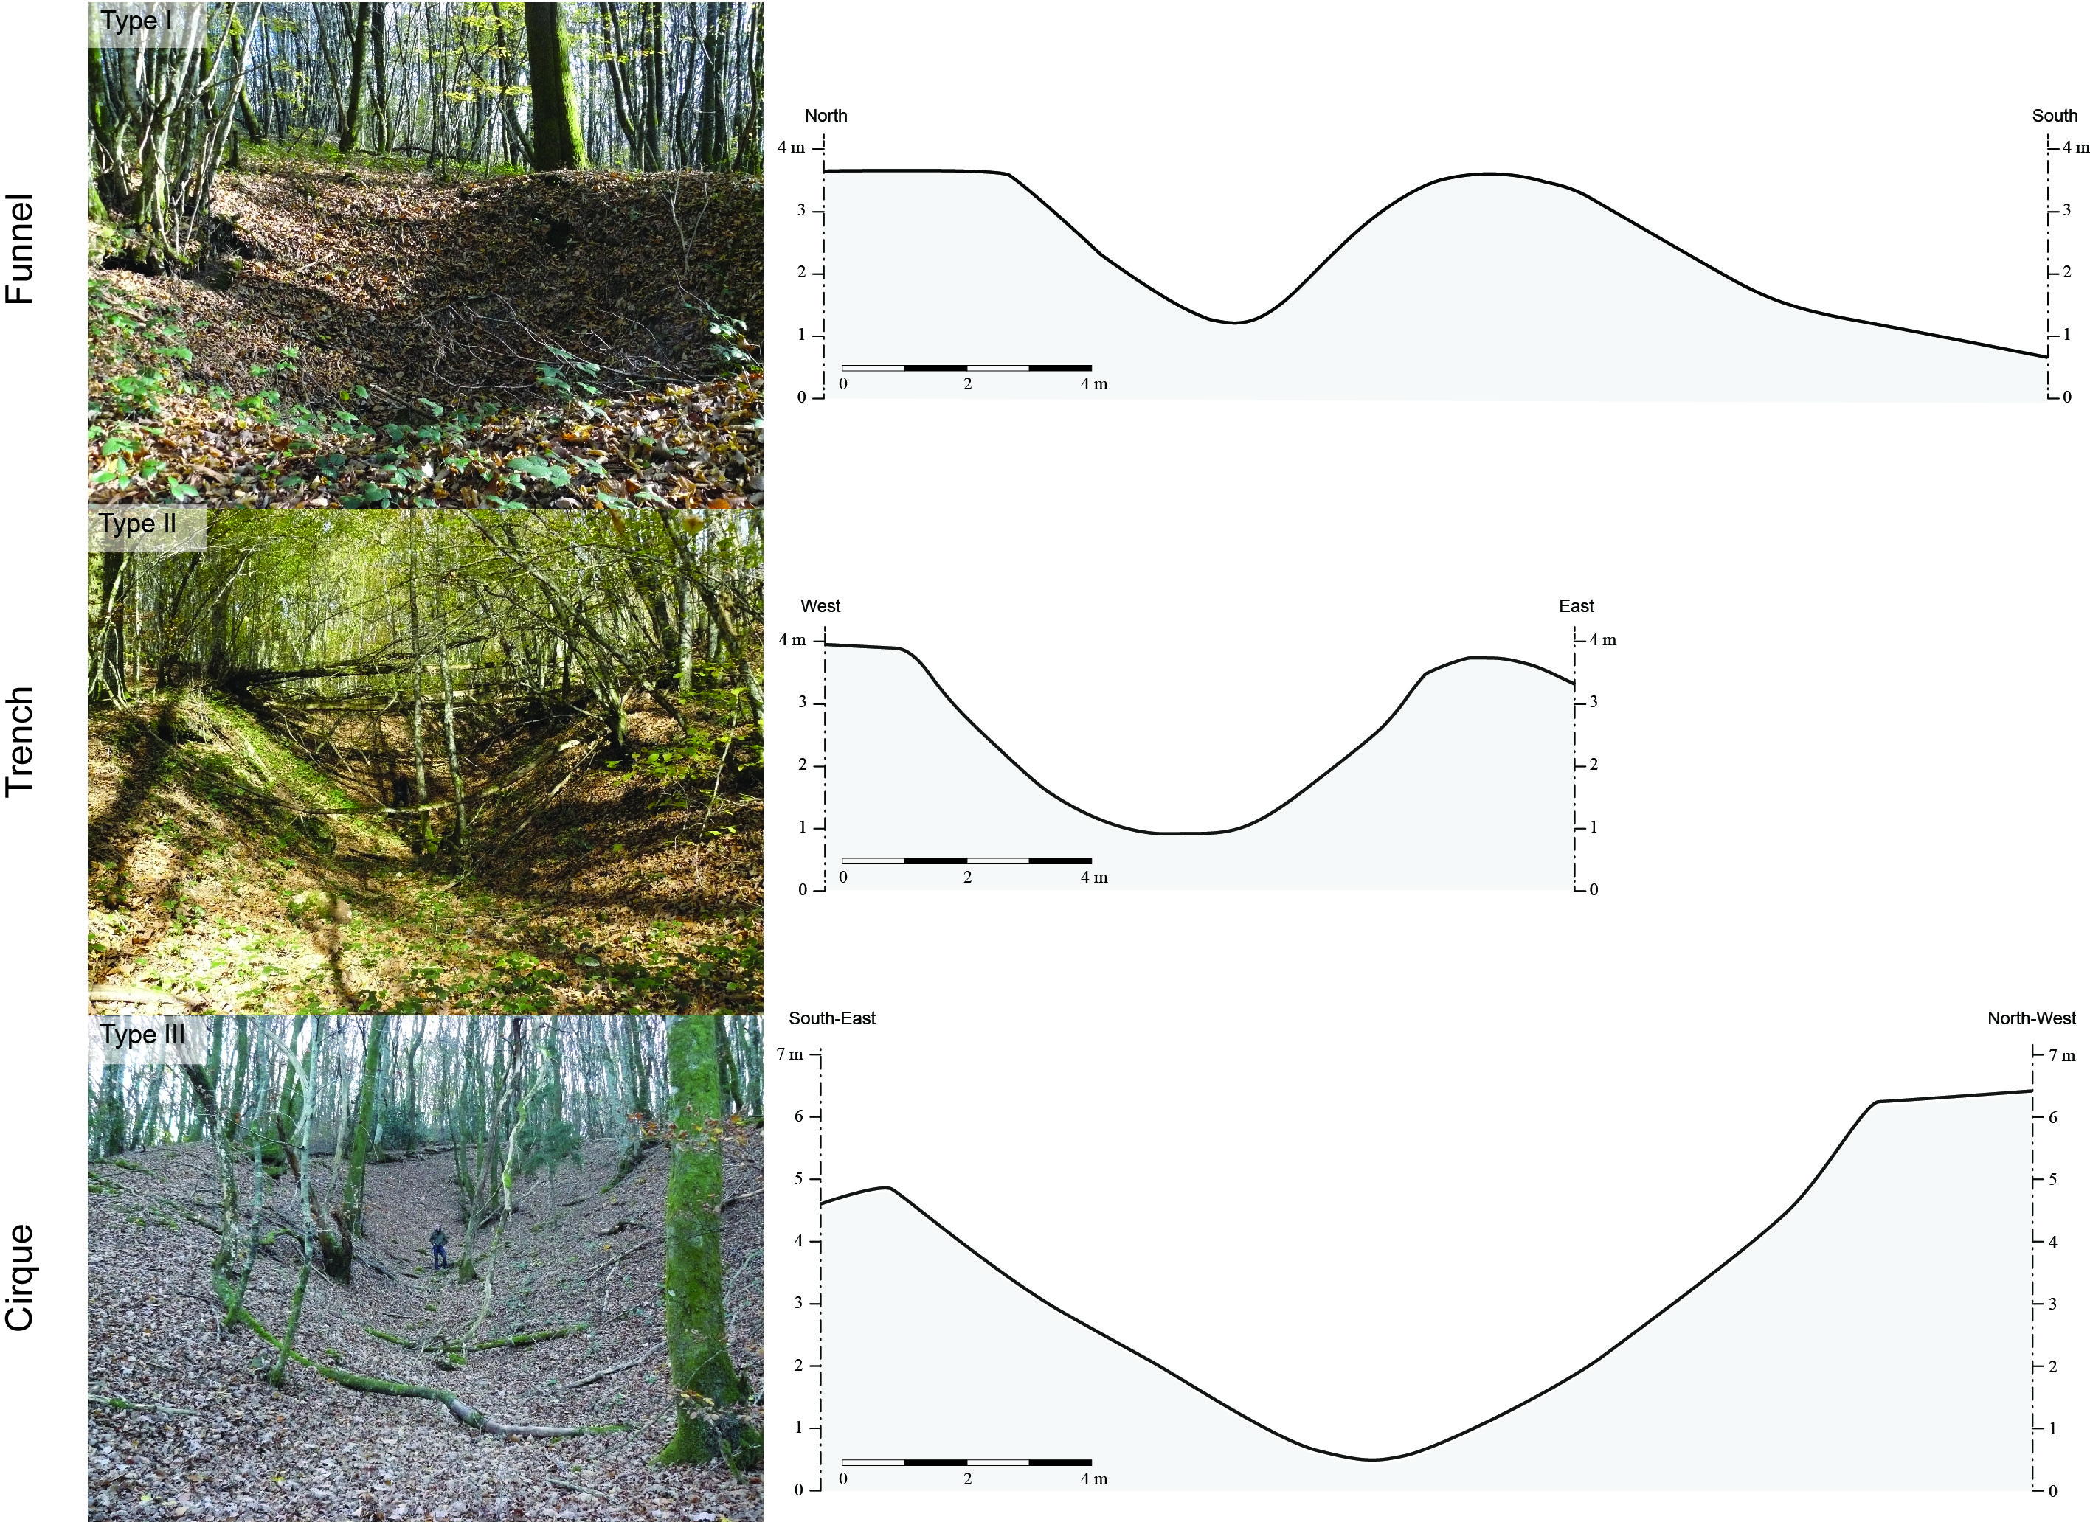
Results – Pedestrial prospection
Hundreds of structures

Slide 10
Results – Pedestrial prospection
110 structures

Slide 11
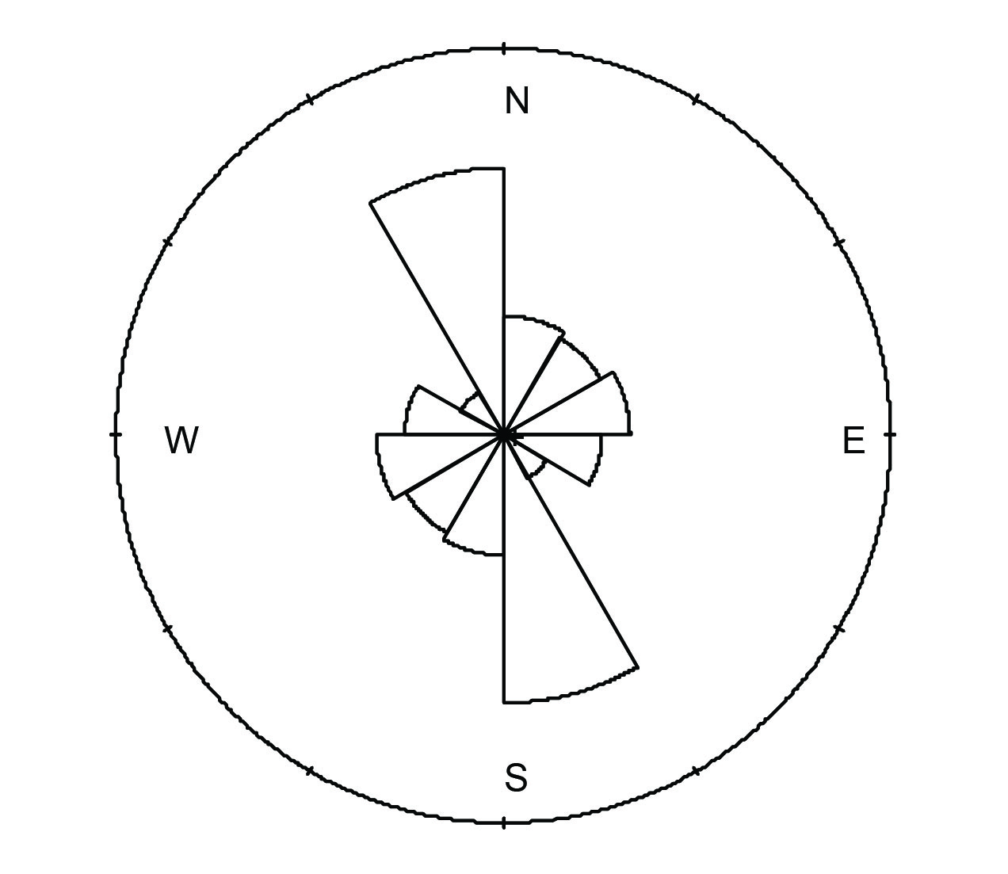
Results – Pedestrial prospection
Orientation

Slide 12
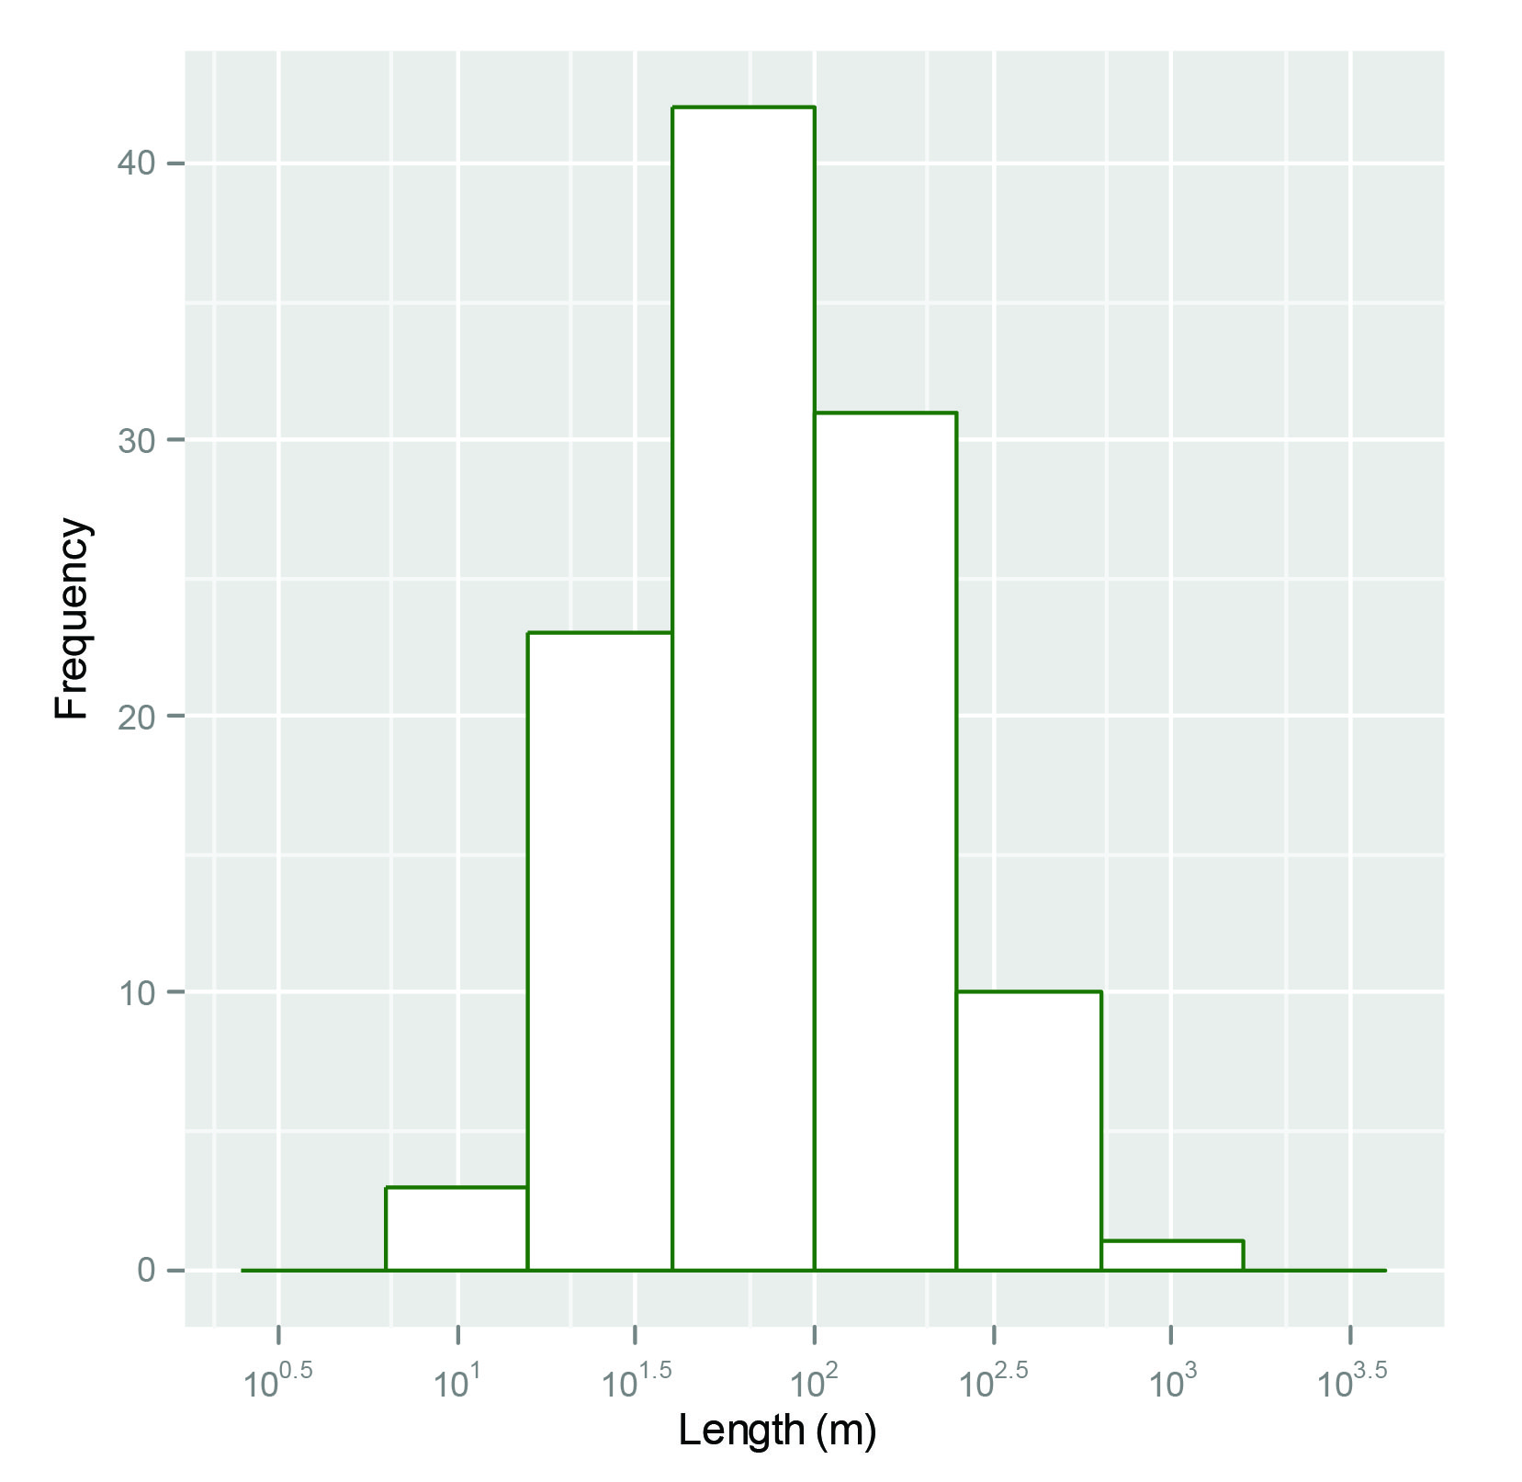
Results – Pedestrial prospection

Slide 13
Results – Pedestrial prospection
15 structures

Slide 14
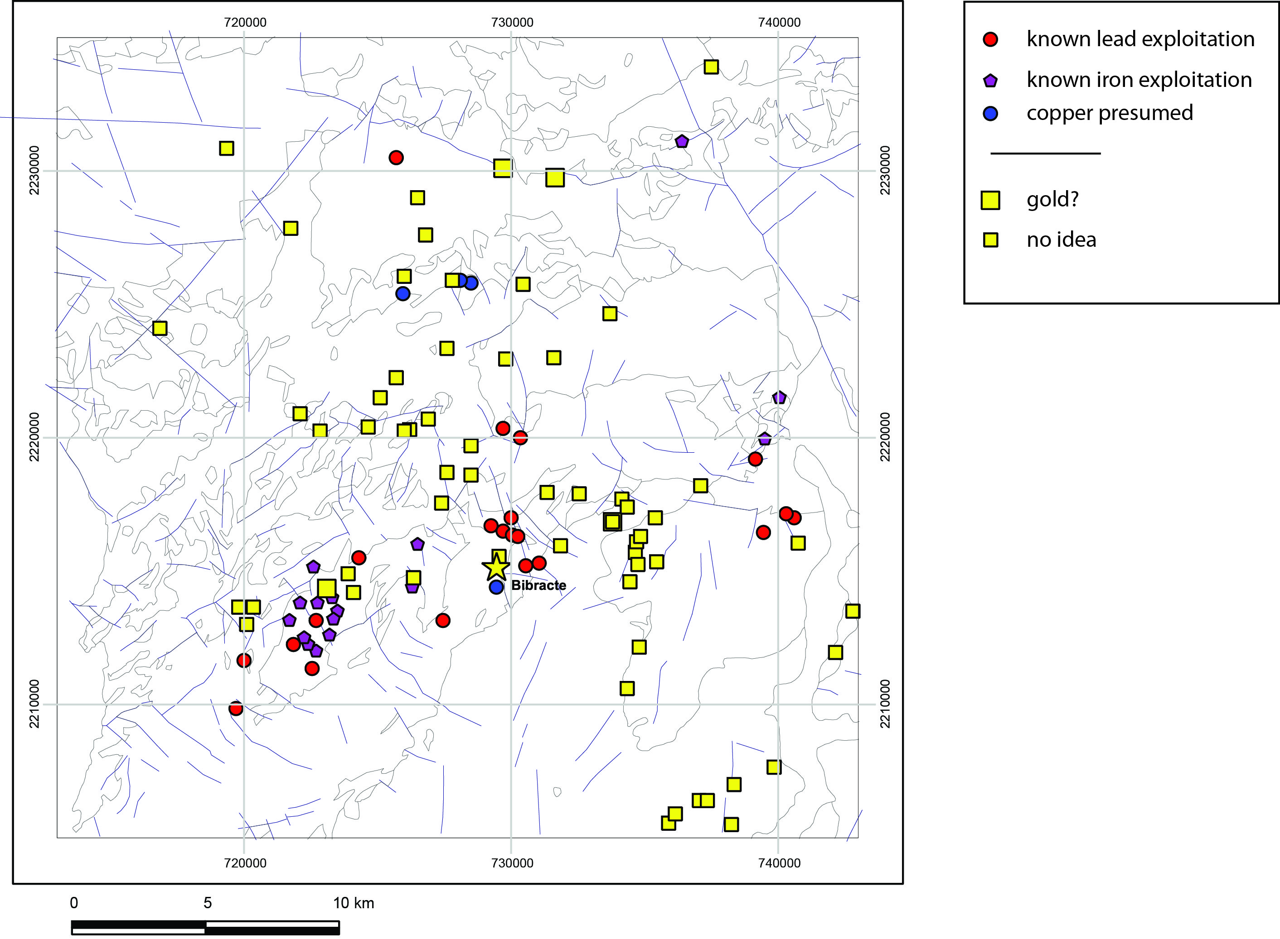
Results – Pedestrial prospection
A total of 104 past and modern mining areas are identified when modern U, Ba, & F mines are removed

Slide 15
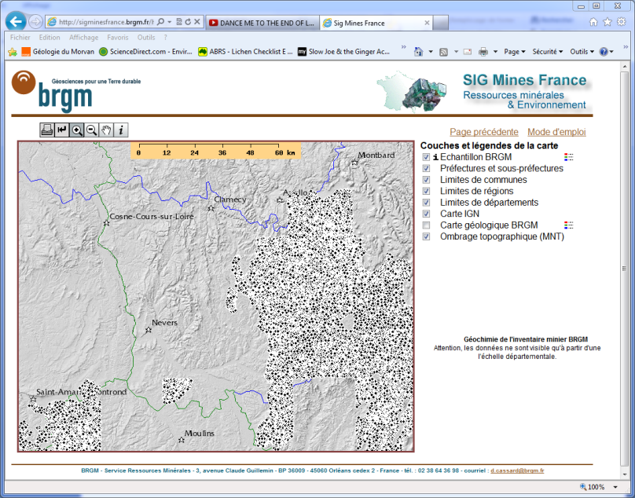
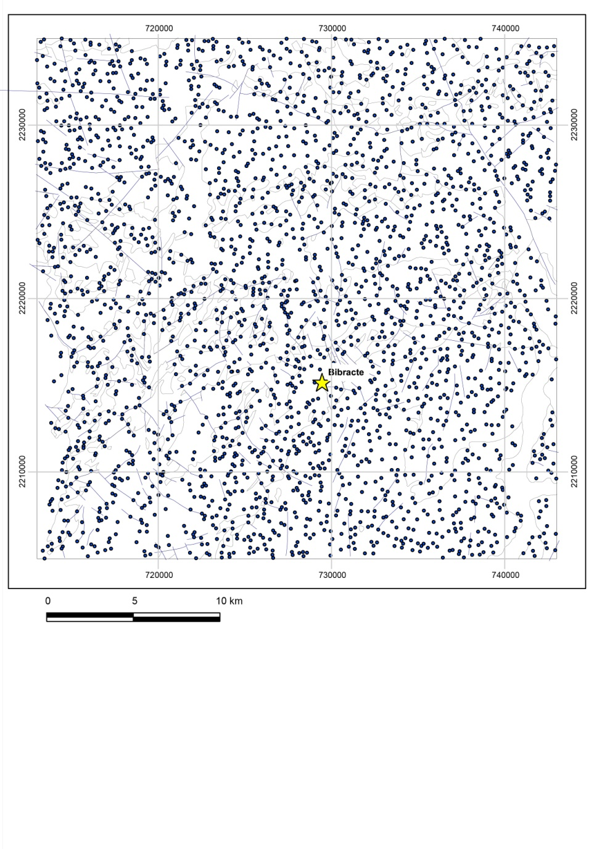
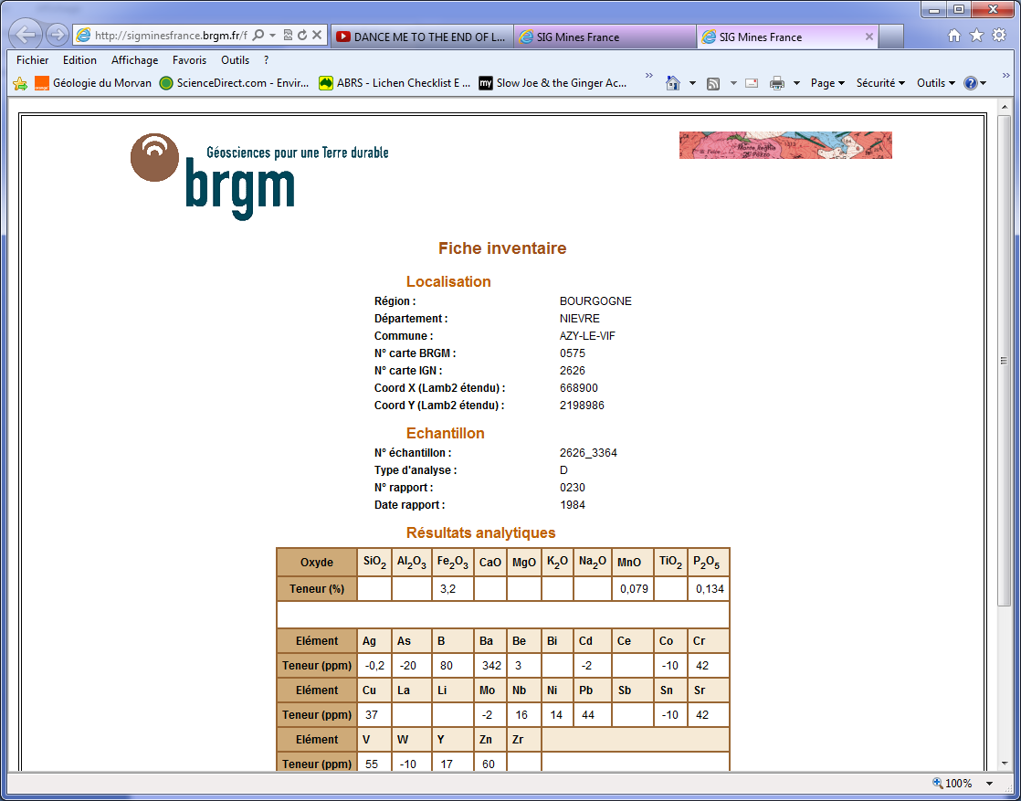
Results – Geochemistry
A total of 2543 stream sediment samples have been collected and analyzed by the BRGM within the pilot study area
http://sigminesfrance.brgm.fr/

Slide 16
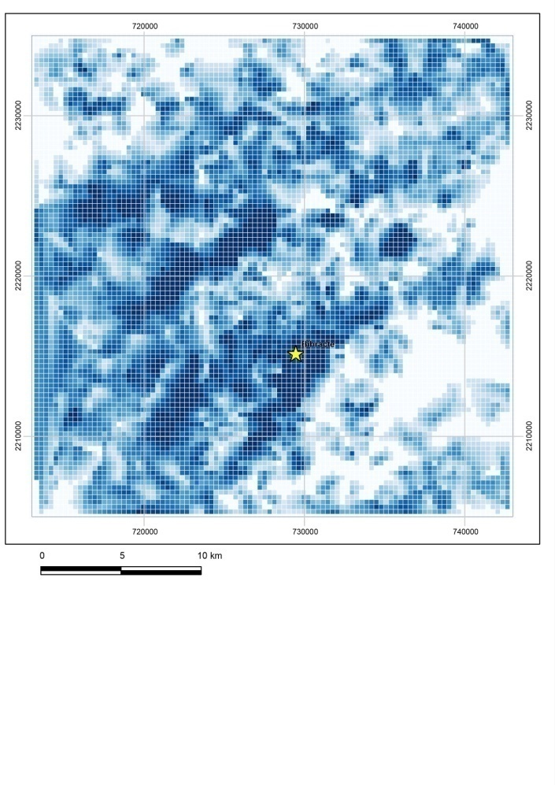
Results – Geochemistry
Interpolating log₁₀(Cu)
-> Geochemical landscape (Cu)
A(r>r_{i}) : the area for which r > r_{i}?
Fractal-based C-A plot: the principle

Slide 17
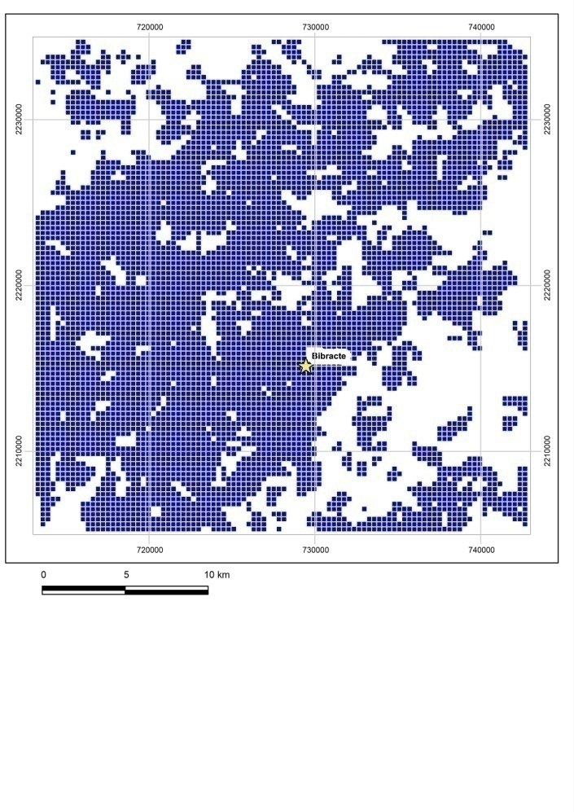
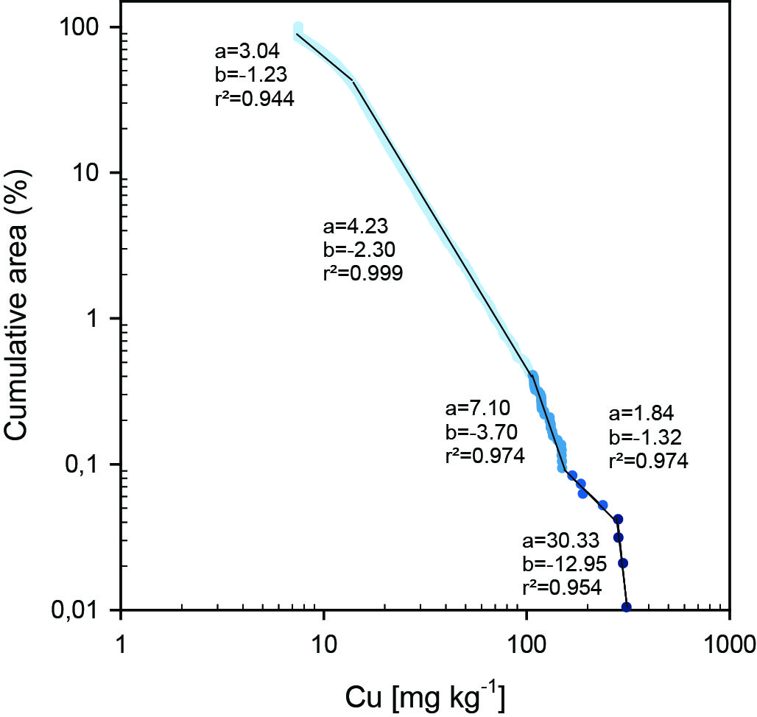
Results – Geochemistry
Interpolating log₁₀(Cu)
-> Geochemical landscape (Cu)
Log₁₀(Cu)>1
A(r>r_{i}) : the area for which r > r_{i}?
Fractal-based C-A plot: the principle

Slide 18
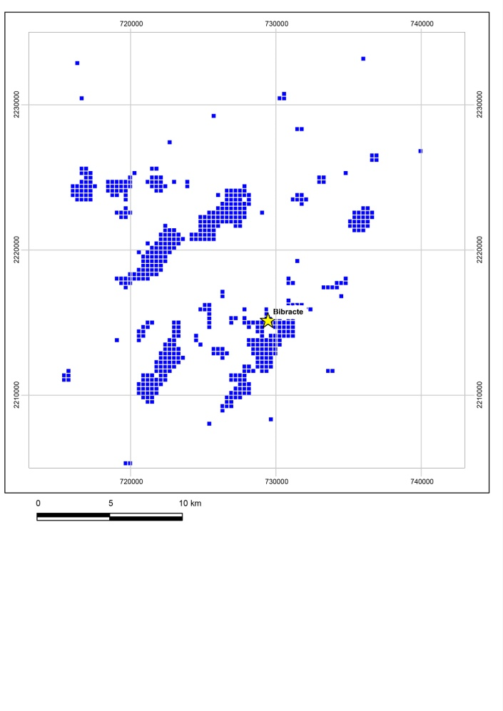
Results – Geochemistry
Interpolating log₁₀(Cu)
-> Geochemical landscape (Cu)
Log₁₀(Cu)>1
Log₁₀(Cu)>1.5
A power law: A(r>r_{i}) = cr_{i}^{-D}
A(r>r_{i}) : the area for which r > r_{i}
c: a constant
D: the fractal dimension
Fractal-based C-A plot: the principle

Slide 19
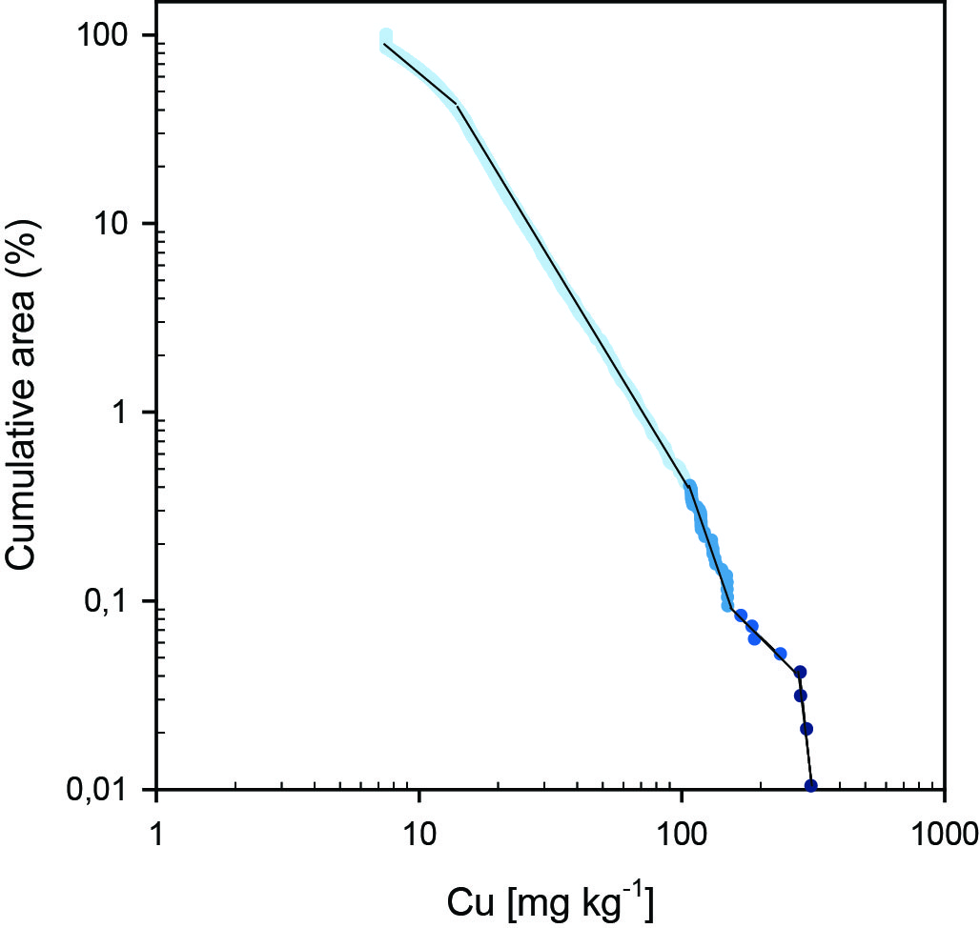
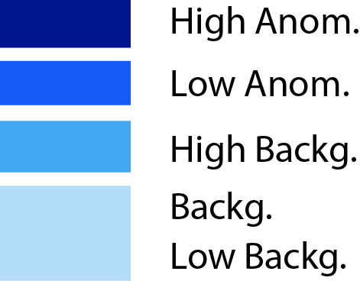
Results – Geochemistry
Low Backg.
Backg.
Changes in fractal
dimension
High Backg.
Low Anom.
High Anom.
Fractal-based C-A plot
More details in Chen et al. (1994) and Carranza (2009)

Slide 20
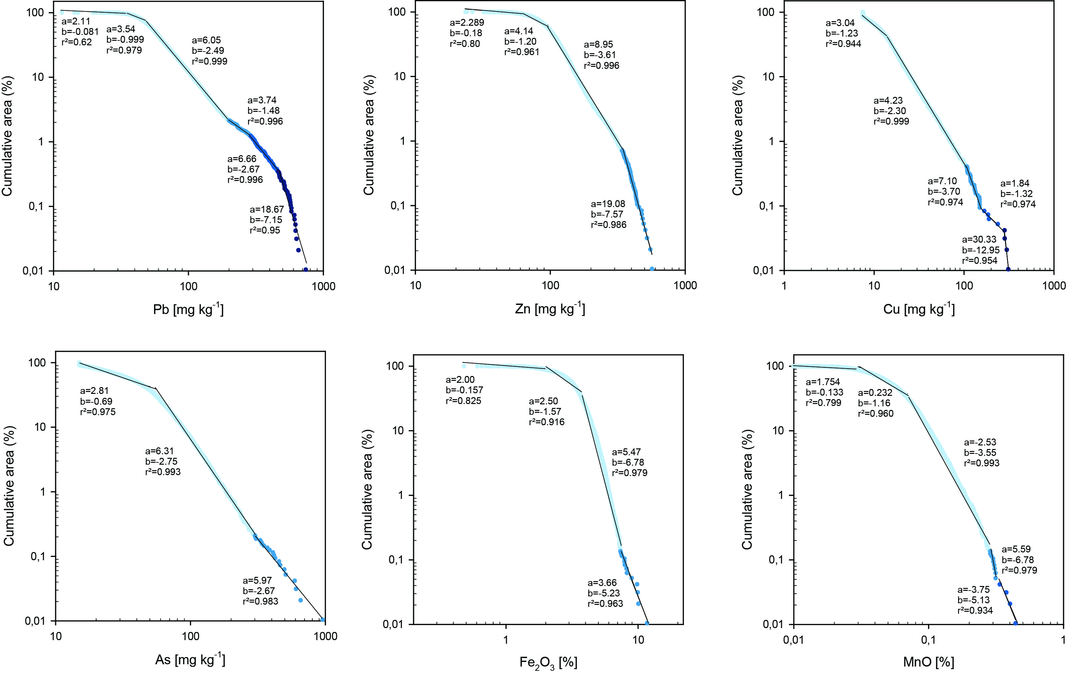
Results – Geochemistry

Slide 21
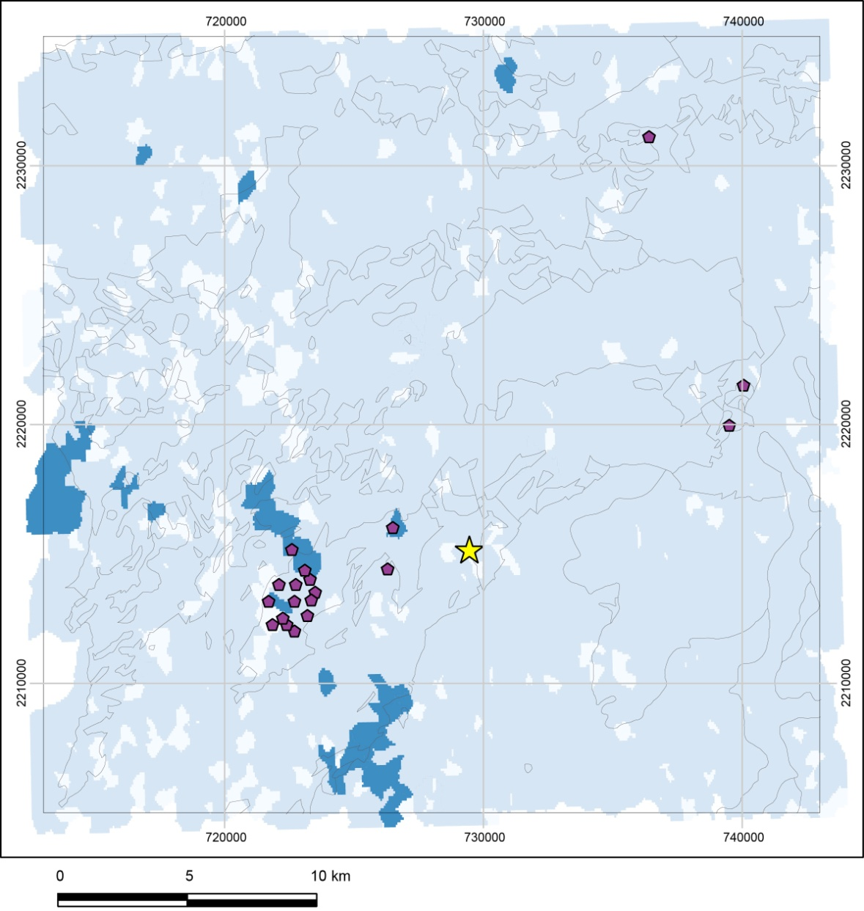
Confronting geochemistry and prospection
Iron anomalies (fractal model) + known iron mines
Iron mining cannot be seen with SSS

Slide 22
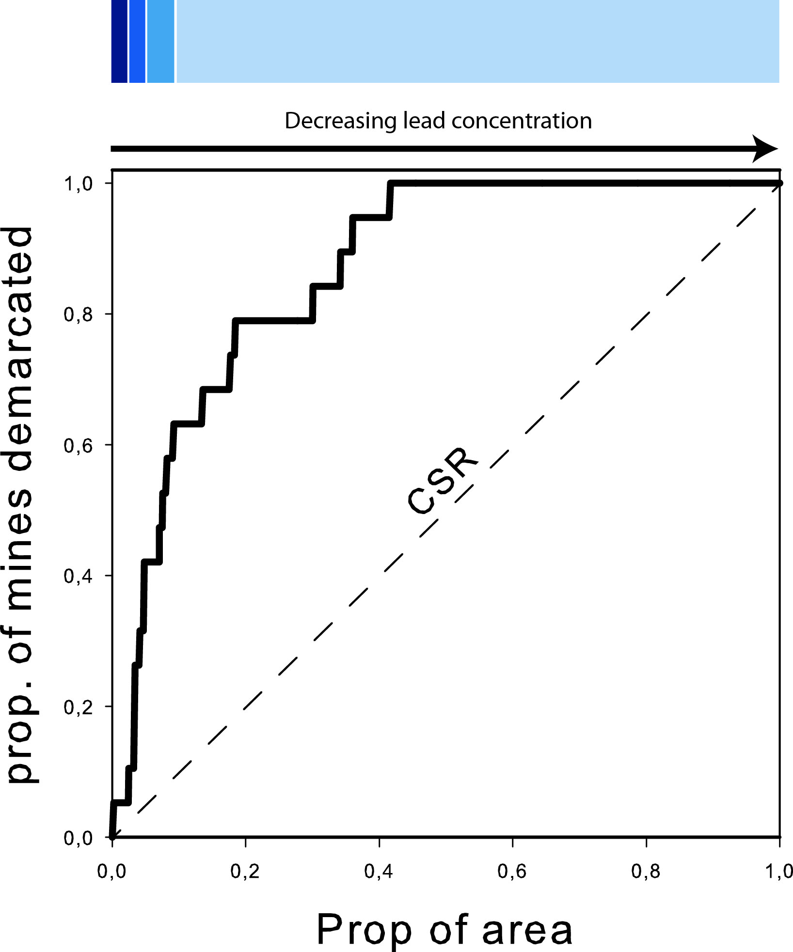
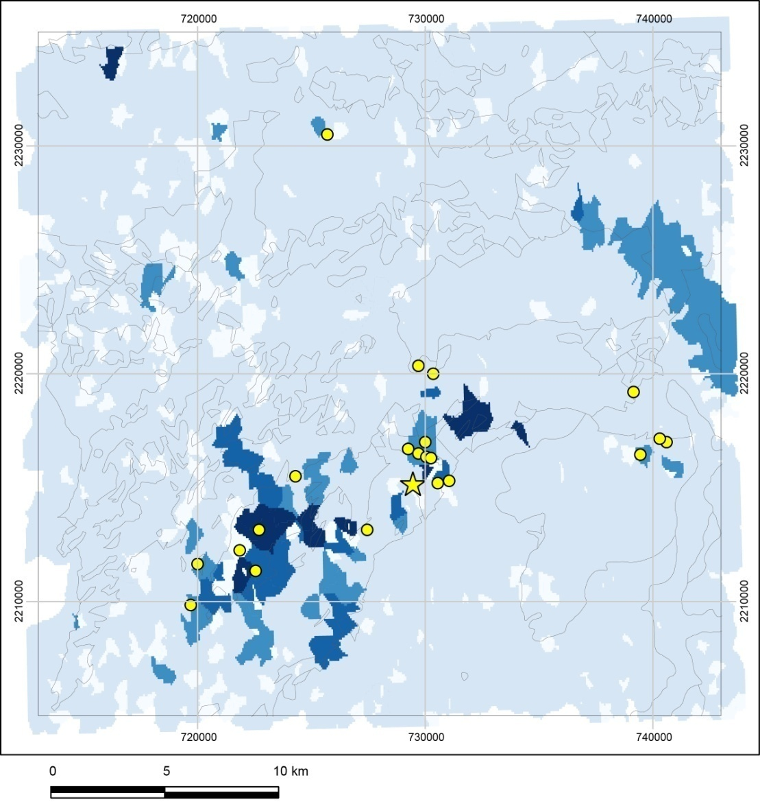
Confronting geochemistry and prospection
Lead anomalies (fractal model) + Pb/Ag mines known

Slide 23
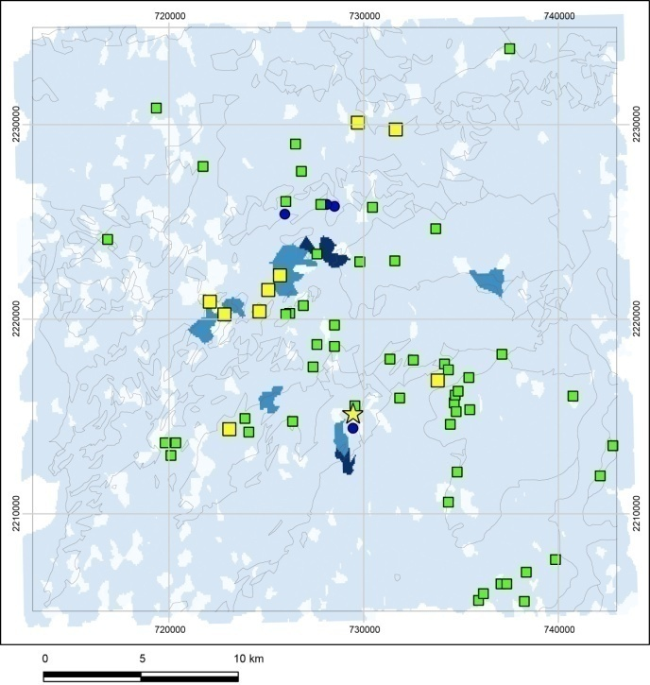
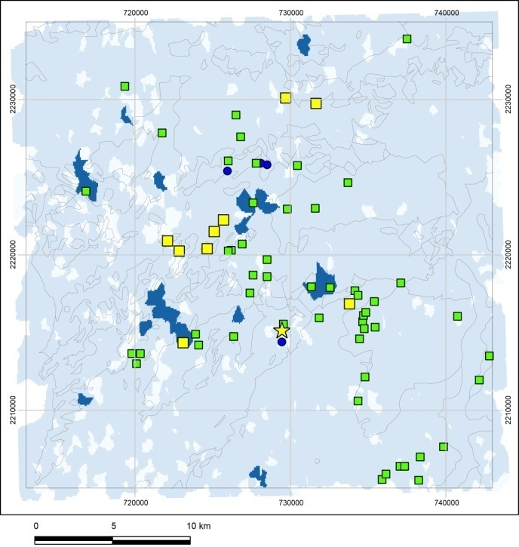
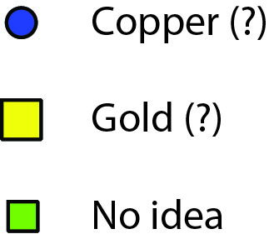
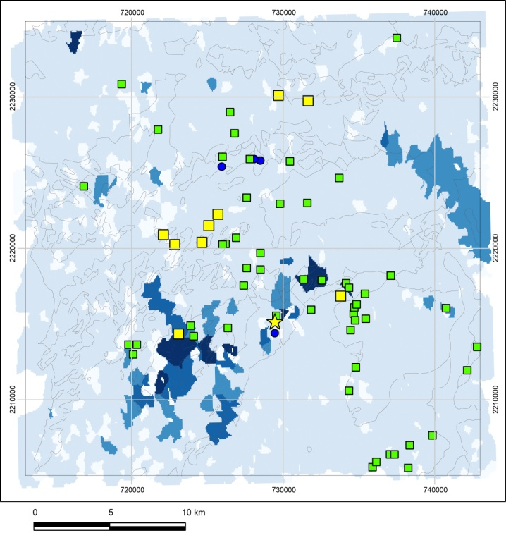
Towards the identification of the exploited substances?
Cu
As
Pb
Exploitation of epithermal Au deposits is doubtful within the pilot study area.
Some units possibly exploited copper, some others argentiferous galena…
The remaining likely focussed on iron.

Slide 24
Conclusion
By treating the geochemical data from stream sediment sampling with the fractal approach, it is possible to focus on non-ferrous mining (more particularly on Ag/Pb mining).
The Tukey’s EDA procedure (not shown here) provides approximately the same (GOOD) results: ca 80% of Ag/Pb mines (representing 15-30 rather small units) can be discovered by prospecting only 20% of the total area.
Cu, and more particularly Au, mining was probably not the point in this area. Fe ore deposit was likely the main target.
The procedure is easy to implement (if geochemical data are available obviously), and can be of great value for an archaeological purpose.
The next step (in progress): Enhancing the procedure to the whole Morvan region.

Slide 25
Conclusion
This work is a contribution of the project:
« Identification et impact des sites miniers abandonnés sur les écosystèmes aquatiques et terrestres actuels »

