Slide 1
Archéologues en quête de provenance Artéfacts (et autres…)
Fabrice Monna
Archéologie, cultures et sociétés. UMR 5594 Université de Bourgogne – CNRS, Bâtiment Gabriel, boulevard Gabriel, 21000 Dijon France.
email : Fabrice.Monna@u-bourgogne.fr

Slide 2
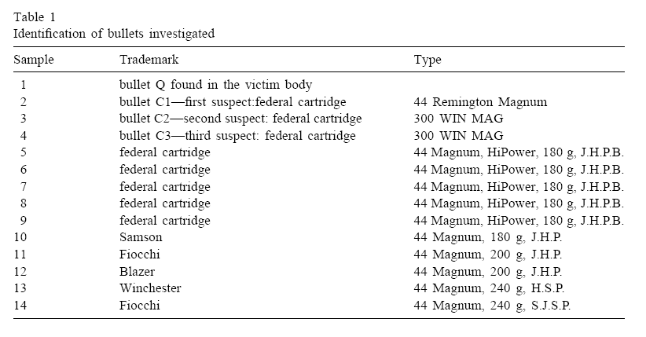
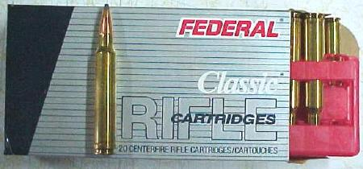
Introduction
Dufosse et Turon (1998)

Slide 3
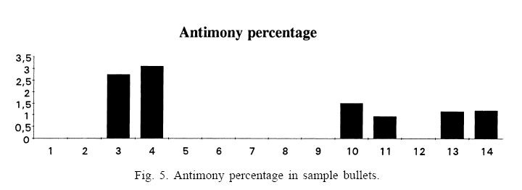
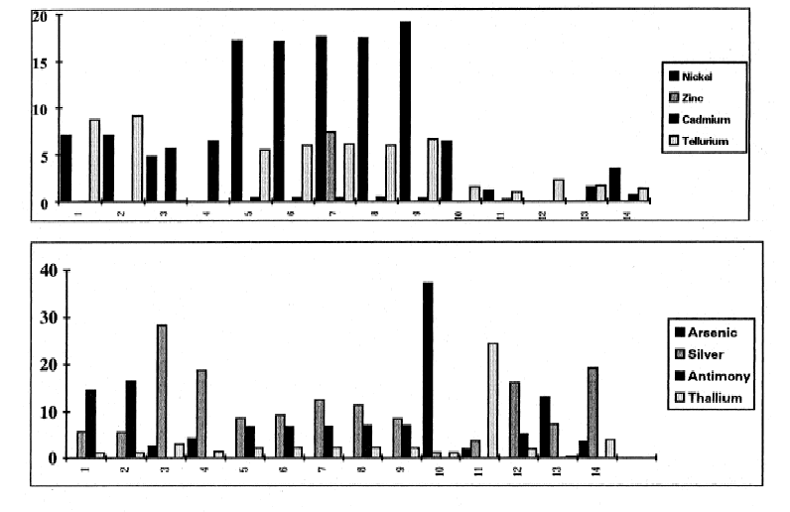
Introduction
Dufosse et Turon (1998)

Slide 4
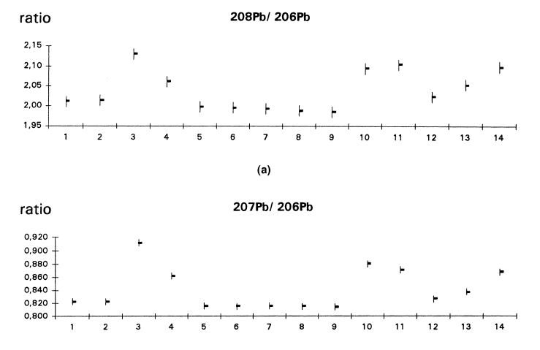
Introduction
Dufosse et Turon (1998)

Slide 5
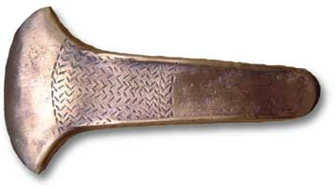
Introduction
Archaeological applications

Slide 6
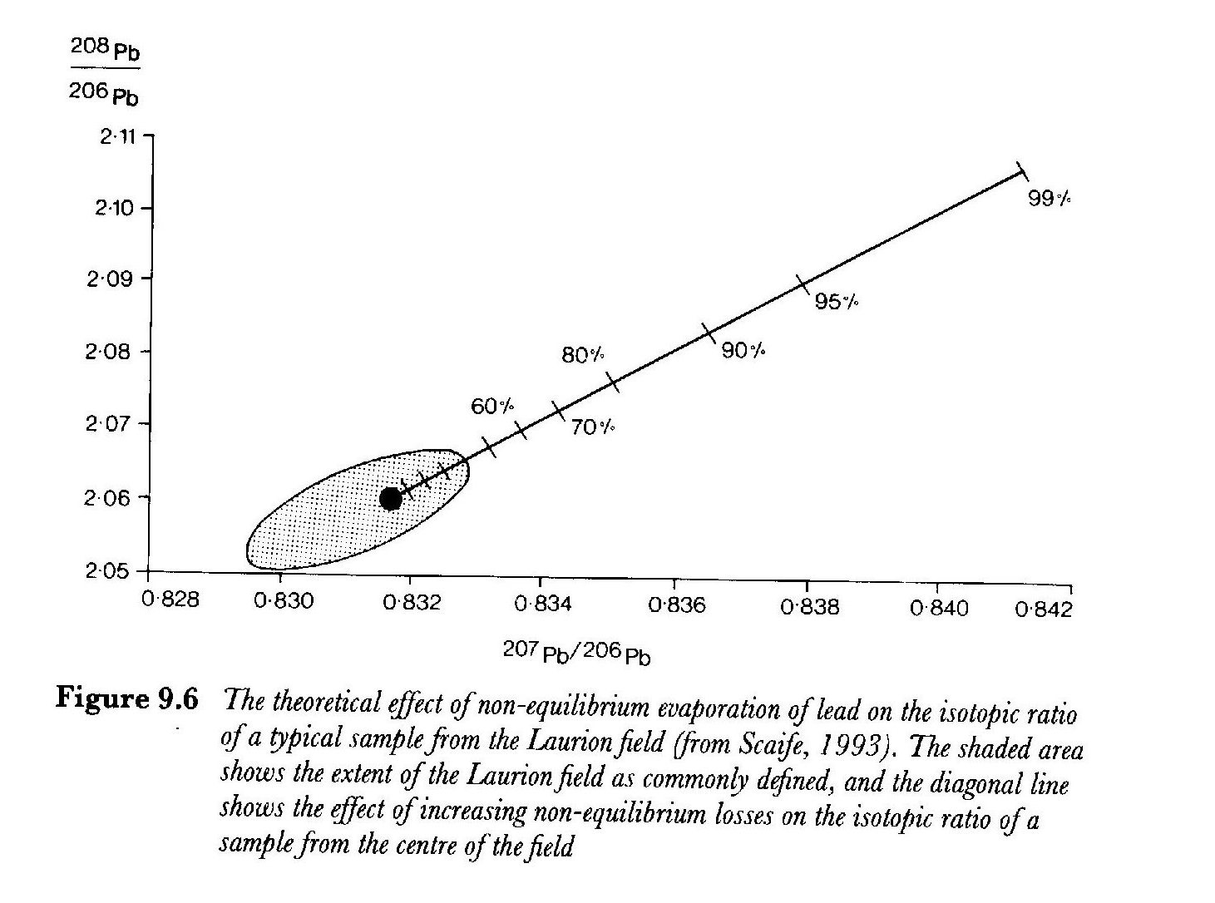
En quête de provenance…
Fractionation??
Pollard and Heron, 1996

Slide 7
En quête de provenance…
Zwicker et al. 1983

Slide 8
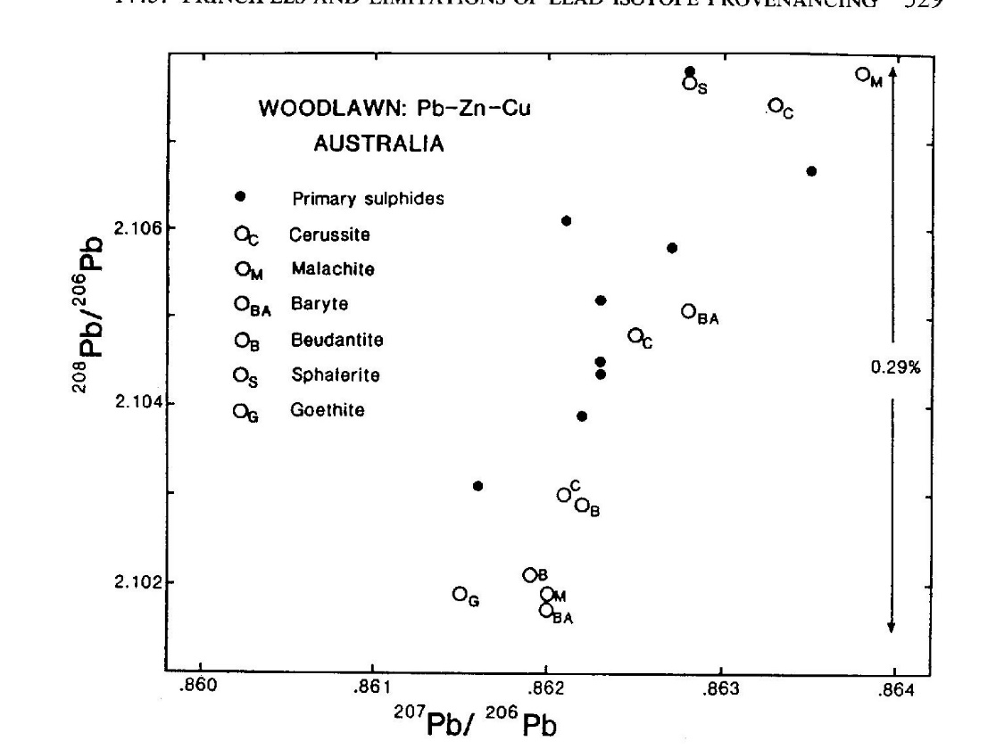
En quête de provenance…
Gulson and Mizon, 1979
Cited in Gale and Stos-Gale (2000)
« Pernicka (1993) has noted that an increasing number of copper minerals can be shown to have a different isotopic signature from the co-existing lead minerals because of incorporation of uranium and/or thorium at the time of the formation of the ore deposit. » cited in Pollard and Heron, (1996)

Slide 9
En quête de provenance…
« Only if all the lead isotope ratios of an artifact fall within the fields for an ore source in both diagrams could that ore source have provided the metal for the artifact. »
Gale and Stos-Gale (2000)
Archaeological applications

Slide 10
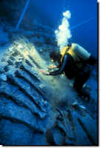
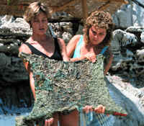
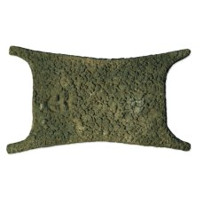
En quête de provenance…
1318 BC (origin Cyprus?, richness in terms of Cu ores)
Bronze Age Shipwreck Excavation at Uluburun, http://ina.tamu.edu/ub_main.htm

Slide 11
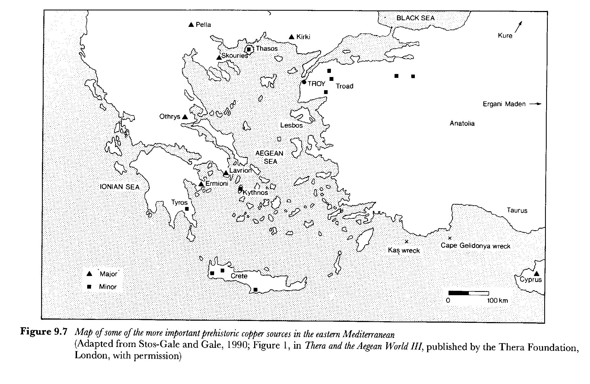
En quête de provenance…

Slide 12
En quête de provenance…
There still remain several unresolved problems with the use of LIA in metals provenance work:
different ore deposits may contain lead that is isotopically indistinguishable - a factor that makes it impossible to assign an artifact or ingot positively to a specific ore source (Pernicka et al. 1990, Reedy and Reedy 1988);
Knapp 2000

Slide 13
En quête de provenance…
« It is largely a question of semantics to engage in arguments that lead isotope analyses can only exclude ore sources and can at best establish only that an ore deposit is consistent with being the metal source for particular artifacts »
Gale and Stos-Gale (2000)

Slide 14
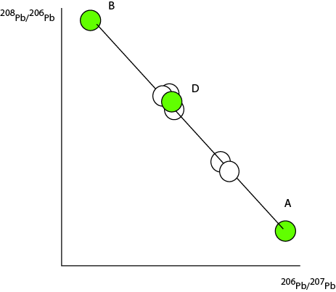
En quête de provenance…

Slide 15
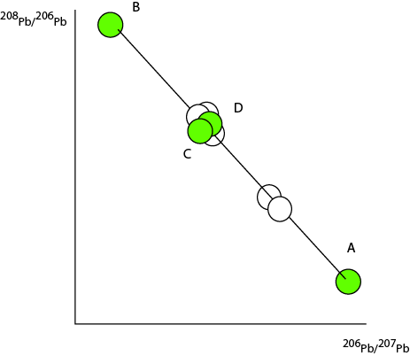
En quête de provenance…

Slide 16
En quête de provenance…

Slide 17
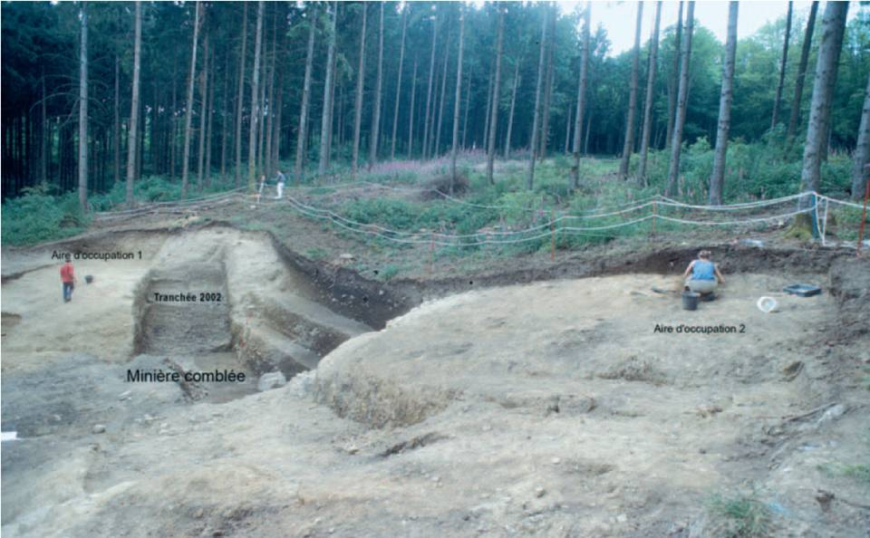
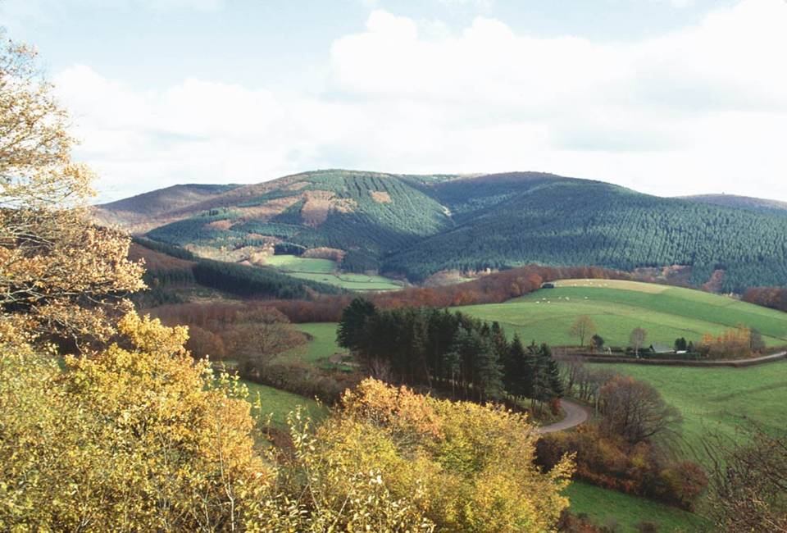
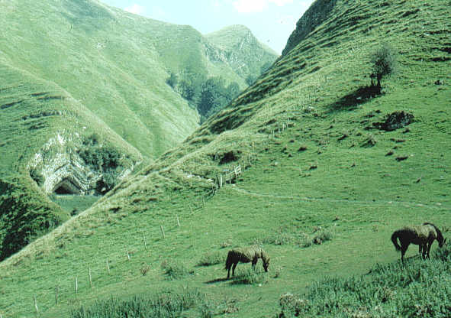
En quête de provenance…
2) not all ore sources are known, and the isotopic variation within each is also therefore unknown (Killick 1992:120-21);

Slide 18
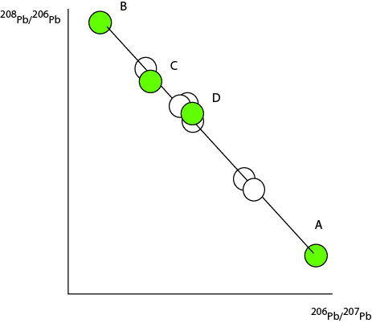
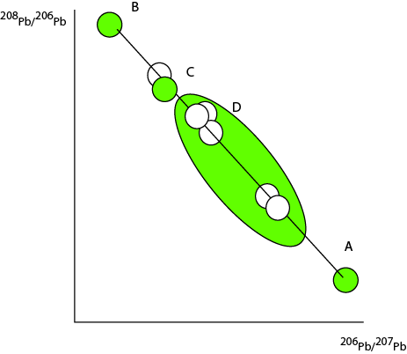
En quête de provenance…

Slide 19
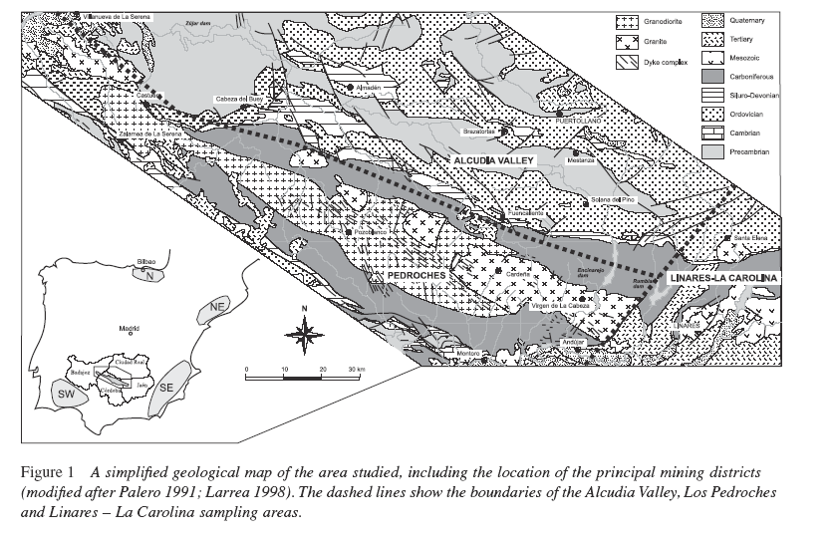
En quête de provenance…
Santos Zalduegui et al. 2004

Slide 20
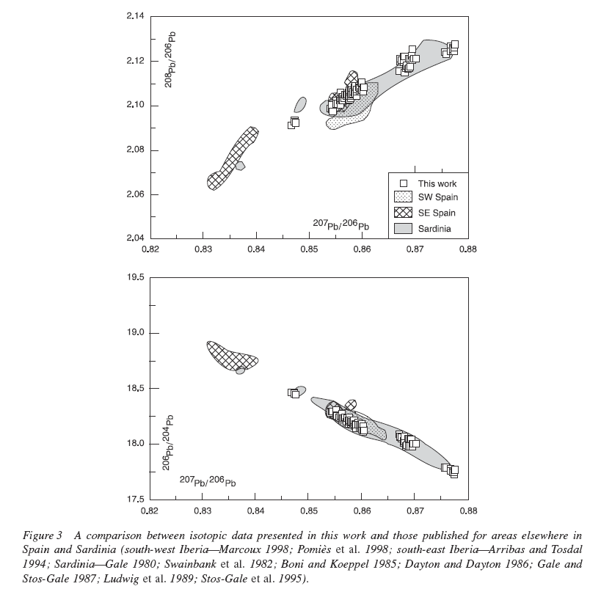
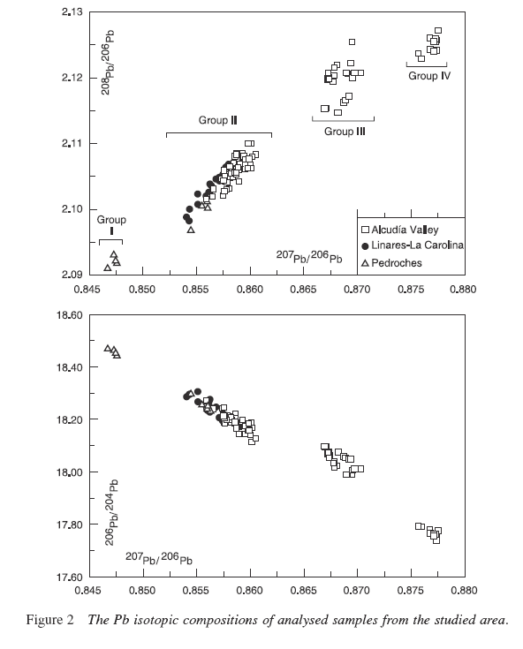
En quête de provenance…
1,20
1,14
Santos Zalduegui et al. 2004

Slide 21
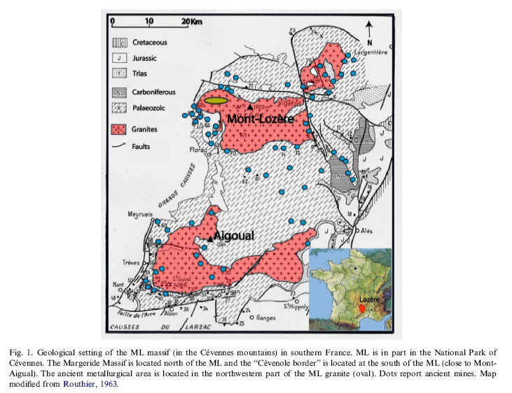
En quête de provenance…
Baron et al. 2006

Slide 22
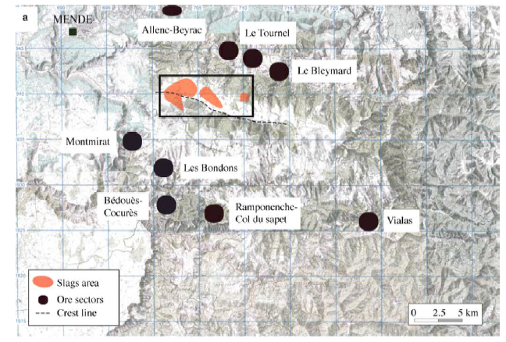
En quête de provenance…
Baron et al. 2006

Slide 23
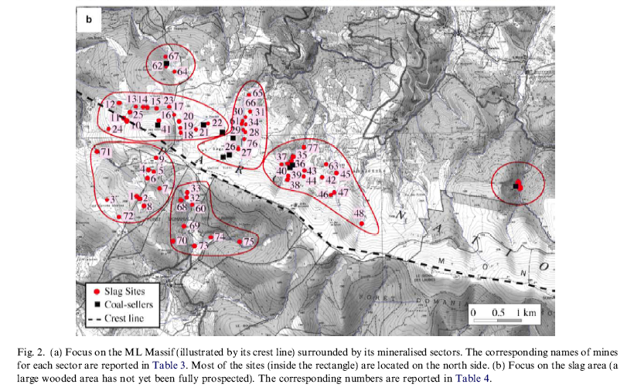
En quête de provenance…
Baron et al. 2006

Slide 24
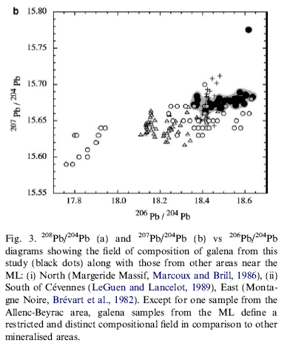
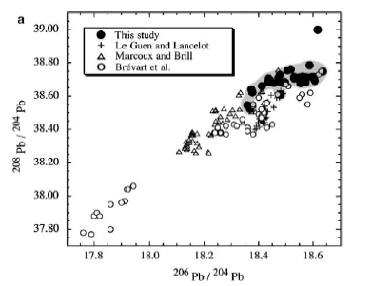
En quête de provenance…
1,14 – 1,19
Baron et al. 2006

Slide 25
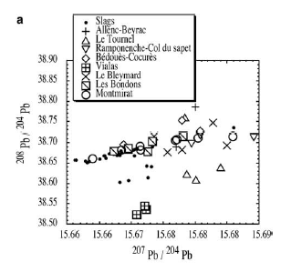
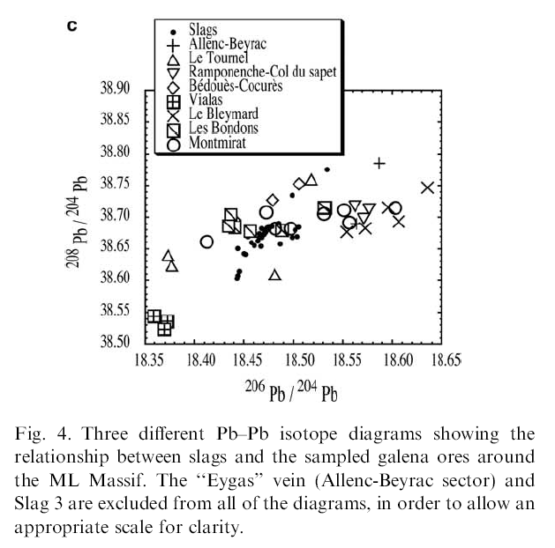
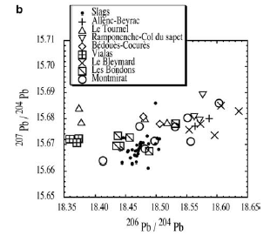
En quête de provenance…
Baron et al. 2006

Slide 26
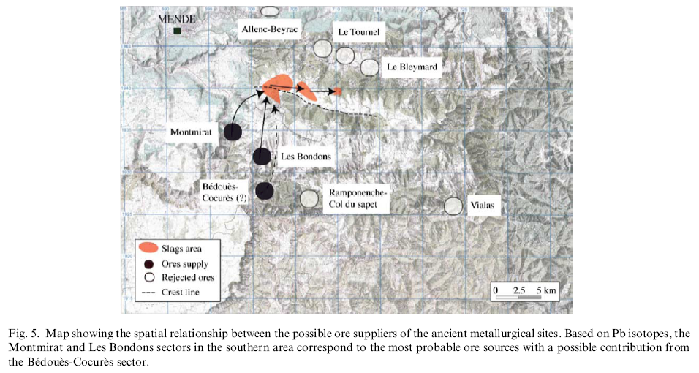
En quête de provenance…

Slide 27
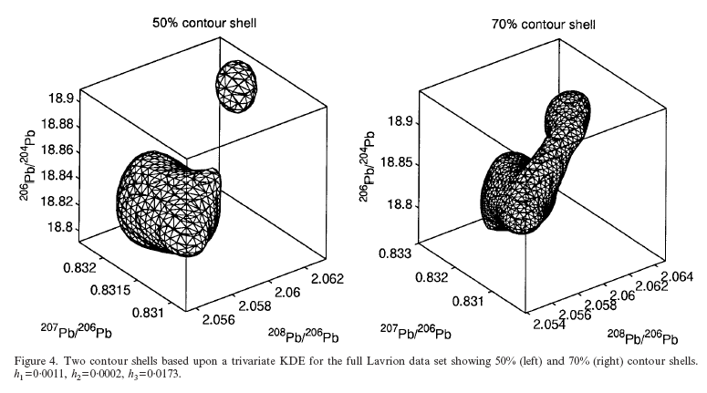
En quête de provenance…
Multivariate normality????
Baxter et al. 2000

Slide 28
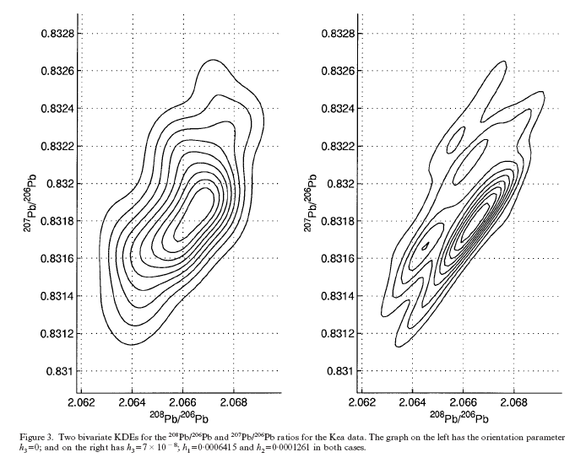
En quête de provenance…
Baxter et al. 2000

Slide 29
En quête de provenance…
3) other materials used in smelting copper (i.e., fuels and fluxes) or alloyed with it (e.g., tin) may contain lead unrelated to that derived from the copper ore;
Not sure… Gale and Stos-Gale (2000)
Coal ≈ 0 Pb
Tin : 15 – 1100 ppm but minor component

Slide 30
En quête de provenance…
4) because human beings were always involved in the extraction of ores and the production and trade of metals and because economic constraints on availability always obtained, it is possible and indeed likely that more than one ore source would have been involved at the manufacturing or refining stage, a factor further compounded by the likely melting and re-use of bronze which may contain lead from several different ore sources (Muhly 1985a; Needham et al. 1989; Budd et al. 1995). Mixing ores from different deposits will provide a lead isotopic ratio that may bear no relationship to an actual ore-body (Killick 1992);

Slide 31
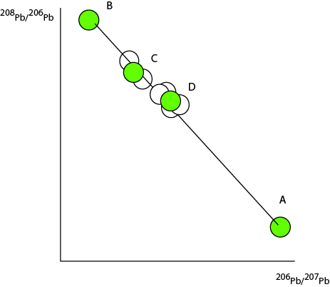
En quête de provenance…

Slide 32
En quête de provenance…
5) finally, it must be pointed out that very few copper or bronze metal artifacts analysed have an isotopic signature which can be correlated with the field established for the copper oxhide ingots (Muhly 1998).

